Slide 1
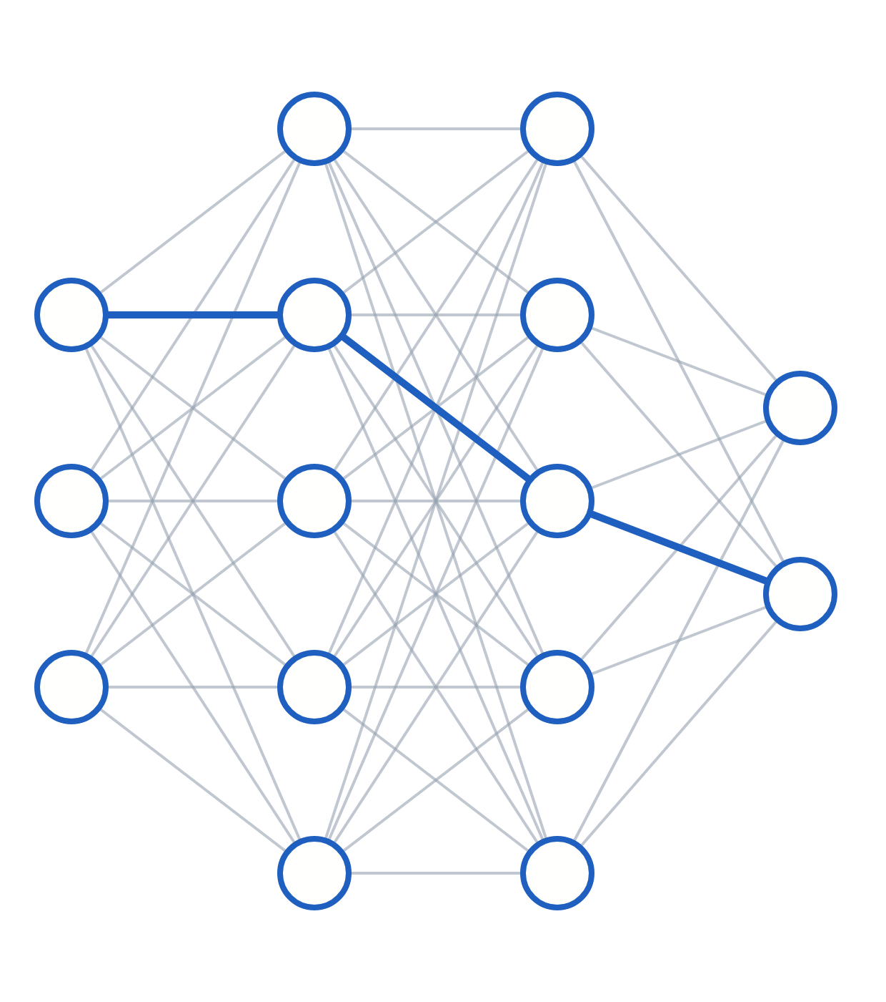
Foundations: from linear models to the MLP
LECTURE 1 OF 3 · SECTIONS 1–4
Why linear models fail, what a neuron computes, why nonlinearity is mandatory, and how a forward pass works.
Neural Networks & Deep Learning · Undergraduate engineering
Notes:
Welcome to the first of three lectures on the foundations of neural networks. Today covers Sections 1 to 4: why linear models are not enough, what a single neuron computes, why the nonlinearity is mandatory, and how the forward pass of a multi-layer perceptron works, with the shapes right. Lecture 2 covers losses, backpropagation and gradient descent. Lecture 3 covers the engineering that makes deep networks train and generalize. I assume you are comfortable with matrix-vector products, partial derivatives and the chain rule, basic probability, and linear and logistic regression.

Slide 2
By the end of this lecture you will be able to explain and derive these five ideas.
LEARNING OBJECTIVES
01
Prove that no linear classifier solves XOR, and show how a two-unit ReLU network does.
02
Interpret wᵀx + b geometrically: orientation, offset and signed distance.
03
Show why stacked linear layers collapse, and choose an activation for each layer role.
04
Write the MLP forward pass with correct shapes in both batching conventions.
05
State the universal approximation theorem with its four qualifications.
Lecture 1 · Foundations: from linear models to the MLP
02 / 30
Notes:
Here is what you should be able to do by the end of today. Each objective is something you can test yourself on: a proof, an interpretation, a derivation, a set of shapes, or a precise theorem statement. If at the end of the lecture any one of these feels shaky, that is the part of the tutorial to reread.

Slide 3
Fix the notation once: square brackets index layers, round brackets index examples.
NOTATION
Symbol | Meaning
x | Scalar (plain type)
x, W | Vector, matrix (bold in the tutorial)
x⁽ⁱ⁾ | The i-th training example
W[l], b[l] | Weights and biases of layer l
z[l] | Pre-activation of layer l
a[l] | Activation of layer l
a[2](7) | Layer 2, example 7
Symbol | Meaning
g, g′ | Activation and its derivative
L | Loss on one example
J | Average loss over a batch
δ[l] | Error signal ∂L/∂z[l]
⊙ | Elementwise product
η | Learning rate
m, n[l] | Batch size, units in layer l
Lecture 1 · Foundations: from linear models to the MLP
03 / 30
Notes:
Fix the notation now, because the bracket distinction trips people up constantly. Square brackets index the layer; round brackets in a superscript index the training example. So a[2](7) is the layer-2 activation for training example 7. Plain lowercase is a scalar. In the tutorial, bold lowercase is a column vector and bold uppercase is a matrix; on these slides context makes the type clear. z is always the pre-activation, before the nonlinearity, and a is the activation after it. L is the loss on one example and J the average over a batch. We will meet delta, the error signal, in Lecture 2. The same notation is used in all three lectures.

Slide 4
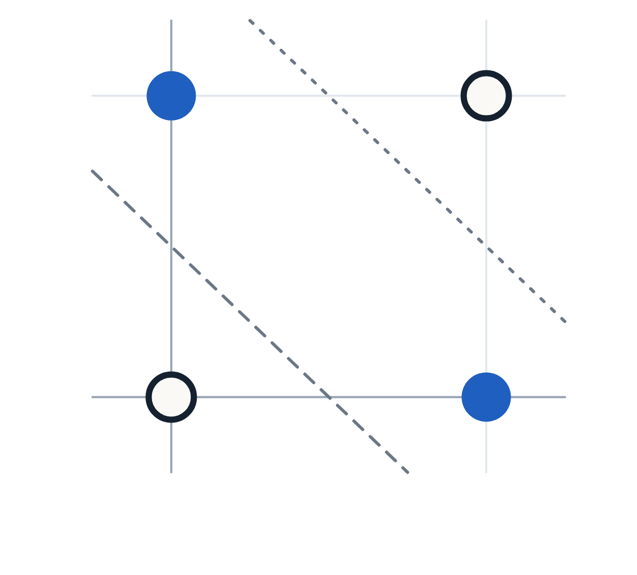
No straight line separates XOR, so a linear classifier cannot solve it.
§1 · WHY WE NEEDED NEURAL NETWORKS
Assume a linear classifier predicts 1 when w₁x₁ + w₂x₂ + b > 0.
1
1
(0,0) → y = 0 ⇒ b ≤ 0
2
(0,1) → y = 1 ⇒ w₂ + b > 0
3
(1,0) → y = 1 ⇒ w₁ + b > 0
x₂
4
(1,1) → y = 0 ⇒ w₁ + w₂ + b ≤ 0
Add rows 2 and 3: w₁ + w₂ + 2b > 0
0
Since b ≤ 0: w₁ + w₂ + b > 0, contradicting row 4
0
x₁
1
No linear classifier can separate XOR.
● y = 1
○ y = 0
lines fail
Lecture 1 · Foundations: from linear models to the MLP
04 / 30
Notes:
Your first machine learning course gave you models of the form w transpose x plus b. They are lovely models: their training losses are convex in the weights, so optimization is reliable; interpretable, since each weight says how much a feature moves the score; and they need little data. But they share one fatal limitation: the decision boundary is a straight line, or a hyperplane in higher dimensions. XOR is the classic demonstration. Put four points on the unit square; the two labelled one sit on one diagonal and the two labelled zero sit on the other. Try to draw a single line with both filled points on one side and you will always catch a hollow one too. The proof builds one line per click. Points two and three force w1 plus b and w2 plus b to be positive. Add them, use b less than or equal to zero, and you get w1 plus w2 plus b greater than zero, which directly contradicts point four. No linear classifier exists. And this is not a quirk of XOR: most real decision boundaries are curved. Advance through the proof one line at a time and ask the class to predict each next step before revealing it.

Slide 5
A hard problem in one representation can be an easy problem in another.
§1 · WHY WE NEEDED NEURAL NETWORKS
x₁ | x₂ | x₁x₂ | y
0 | 0 | 0 | 0
0 | 1 | 0 | 1
1 | 0 | 0 | 1
1 | 1 | 1 | 0
WHY HAND-BUILT FEATURES DO NOT SCALE
Needs the answer first. No one can write down which function of 150,528 pixels means “cat”.
Explodes combinatorially. Degree-3 products of 1,000 inputs number about n³/6 — over 10⁸ features.
Does not transfer. Face-detection features are largely useless for MRI scans.
LINEAR IN THE NEW FEATURE SPACE
y = x₁ + x₂ − 2·x₁x₂
Lecture 1 · Foundations: from linear models to the MLP
05 / 30
Notes:
The classical escape route was feature engineering. Add a third feature, the product x1 times x2. Now y equals x1 plus x2 minus twice the product gives exactly 0, 1, 1, 0. The data did not change; the representation did. That is the key insight of the whole field, so it is worth saying twice: a hard problem in one representation can be an easy problem in another. Kernel methods automate this by working implicitly in a very high-dimensional feature space. So why not stop there? Three failure modes, all getting worse with scale. First, you need to already know the answer. For XOR the product is obvious, but no one can write down which function of 150,528 pixel values indicates a cat. Second, it explodes: degree-three products of a thousand inputs run to hundreds of millions of features. Third, it does not transfer: face features do nothing for tumour detection.

Slide 6
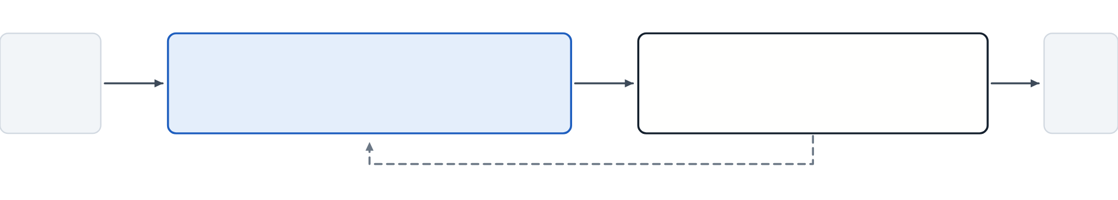
A neural network learns its own features jointly with the linear model on top.
§1 · WHY WE NEEDED NEURAL NETWORKS
Learned feature extractor
Linear model on top
x
ŷ
h = g(W x + c)
ŷ = wᵀh + b
both trained jointly by gradient descent on the same loss
Task-driven
Reusable
Composable
Shaped by the loss you care about, not an expert’s guess.
Early layers learn edge and texture detectors useful for most vision tasks.
Edges → corners → motifs → parts → objects. That hierarchy is “deep”.
Lecture 1 · Foundations: from linear models to the MLP
06 / 30
Notes:
Here is the neural network idea in one sentence. Instead of designing a fixed transformation phi of x and fitting a linear model on top, use a transformation with its own adjustable parameters, and learn those parameters at the same time as the linear model. Formally, h equals g of W x plus c is a learned representation, with g a nonlinear function applied elementwise, and the prediction is a linear model on h. Both blocks are trained together by gradient descent on the same loss. That single change buys three things. The features are task-driven. They are reusable, which is the root of transfer learning. And they are composable: layer two builds features from layer one's features, and so on up the hierarchy. That hierarchy is what the word deep refers to.

Slide 7
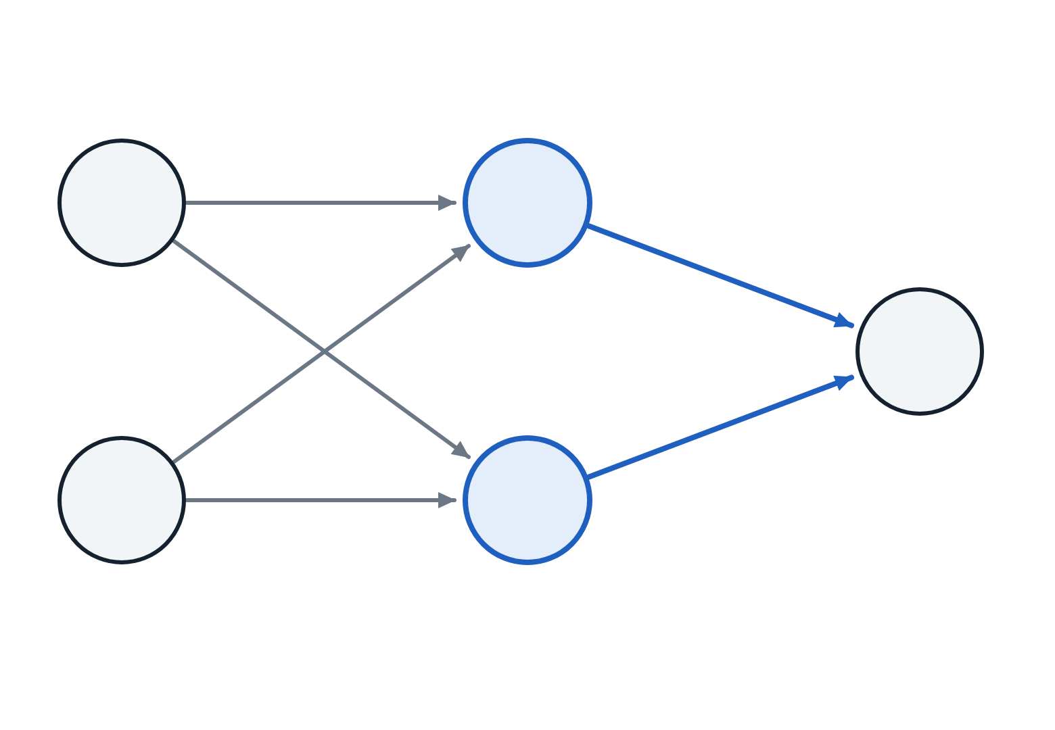
Two ReLU hidden units, one OR-like and one AND-like, solve XOR exactly.
§1 · WHY WE NEEDED NEURAL NETWORKS
x₁ | x₂ | h₁ | h₂ | y | target
0 | 0 | 0 | 0 | 0 | 0
0 | 1 | 1 | 0 | 1 | 1
1 | 0 | 1 | 0 | 1 | 1
1 | 1 | 2 | 1 | 0 | 0
bias 0 · OR-like
x₁
h₁
+1
y
−2
x₂
h₂
Output = OR − 2·AND = XOR, using eight weights and biases. Gradient descent finds decompositions like this on its own.
bias −1 · AND-like
all input-to-hidden weights = 1 · g = ReLU
Lecture 1 · Foundations: from linear models to the MLP
07 / 30
Notes:
You do not need training to see that this works. Take two hidden units with ReLU, g of z equals max of zero and z. The tutorial deliberately shows a near-miss first: with thresholds of 0.5 and 1.5, the outputs come out 0, 0.5, 0.5 and 0.5. That last value is the problem, because the point (1,1) should be class zero but looks exactly like the class-one points. The repair is instructive. The second unit needs to fire harder once both inputs are on, so that subtracting it pulls the output back down. Use h1 equals ReLU of x1 plus x2, h2 equals ReLU of x1 plus x2 minus one, and y equals h1 minus two h2. Trace the table: 0, 1, 1, 0. Exact. Notice what the hidden units became: h1 is OR-like, h2 is AND-like, and the output computes OR minus twice AND. Nobody told the network to build OR and AND detectors; this is the kind of decomposition gradient descent discovers on its own. Quick check for later: if g were the identity, the whole thing collapses back to a linear model.

Slide 8
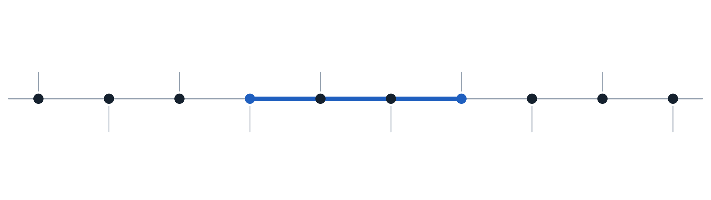
Backpropagation existed by 1986, but it took until 2012 to dominate.
§1 · WHY WE NEEDED NEURAL NETWORKS
1943
1969
1998
2012
2017
McCulloch & Pitts threshold neuron
Minsky & Papert: no XOR for perceptrons
LeNet-5 reads cheques
AlexNet: GPUs, ReLU, dropout
Transformer
26 years
1958
1986
2006–09
2015
2020–26
Rosenblatt’s perceptron
Backpropagation popularized
Deep belief nets; ImageNet
ResNet: 152 layers
ViTs, ConvNeXt, self-supervision
The algorithm was not the bottleneck. Data, compute and training engineering were.
Lecture 1 · Foundations: from linear models to the MLP
08 / 30
Notes:
A short history, because the dates explain the field. McCulloch and Pitts gave the first mathematical neuron in 1943. Rosenblatt's perceptron in 1958 came with a convergence guarantee for separable data. In 1969 Minsky and Papert proved single-layer perceptrons cannot do XOR, and funding collapsed. Rumelhart, Hinton and Williams popularized backpropagation in 1986, which made multi-layer training practical. LeNet-5 was reading bank cheques by 1998. ImageNet arrived at the end of the 2000s. Then in 2012 AlexNet won ImageNet by a huge margin, with GPUs, ReLU, dropout and data. ResNet reached 152 layers in 2015, the Transformer appeared in 2017, and since 2020 convolution and attention have converged in practice. The highlighted stretch is the lesson: twenty-six years between backpropagation and its dominance. The algorithm was not the bottleneck. Note that the tutorial's history section says seventeen years at one point; the correct figure is 2012 minus 1986, twenty-six years.

Slide 9
Use a neural network where data is abundant and its structure is hard to describe.
§1 · WHY WE NEEDED NEURAL NETWORKS
REACH FOR SOMETHING ELSE WHEN…
NEURAL NETWORKS WIN ON
Small data
Tabular data
Images
A few hundred rows: regularized linear models, boosted trees or a Gaussian process.
Gradient-boosted trees remain highly competitive. Try them first.
Audio and video
Text
Protein sequences
Hard interpretability
A baseline already works
abundant data with structure that is hard to describe by hand
An auditable logistic regression beats a 50M-parameter network.
Fit the simple model first. It tells you what score is easy.
Lecture 1 · Foundations: from linear models to the MLP
09 / 30
Notes:
Good engineering means knowing the limits of your tool. With a few hundred rows and a dozen features, use regularized linear models, gradient-boosted trees, or a Gaussian process. On structured tabular data, gradient-boosted trees remain highly competitive and often better; that is still debated in 2026, but trying GBDT first on tabular data is sound practice. If a regulator must audit each decision, a logistic regression or a small tree is defensible in a way a fifty-million-parameter network is not. And always fit the simple baseline first, because it is the only way to know whether your network is actually good. Neural networks win where data is abundant and has structure you cannot easily describe: images, audio, video, text and protein sequences. That is the territory of this course.

Slide 10
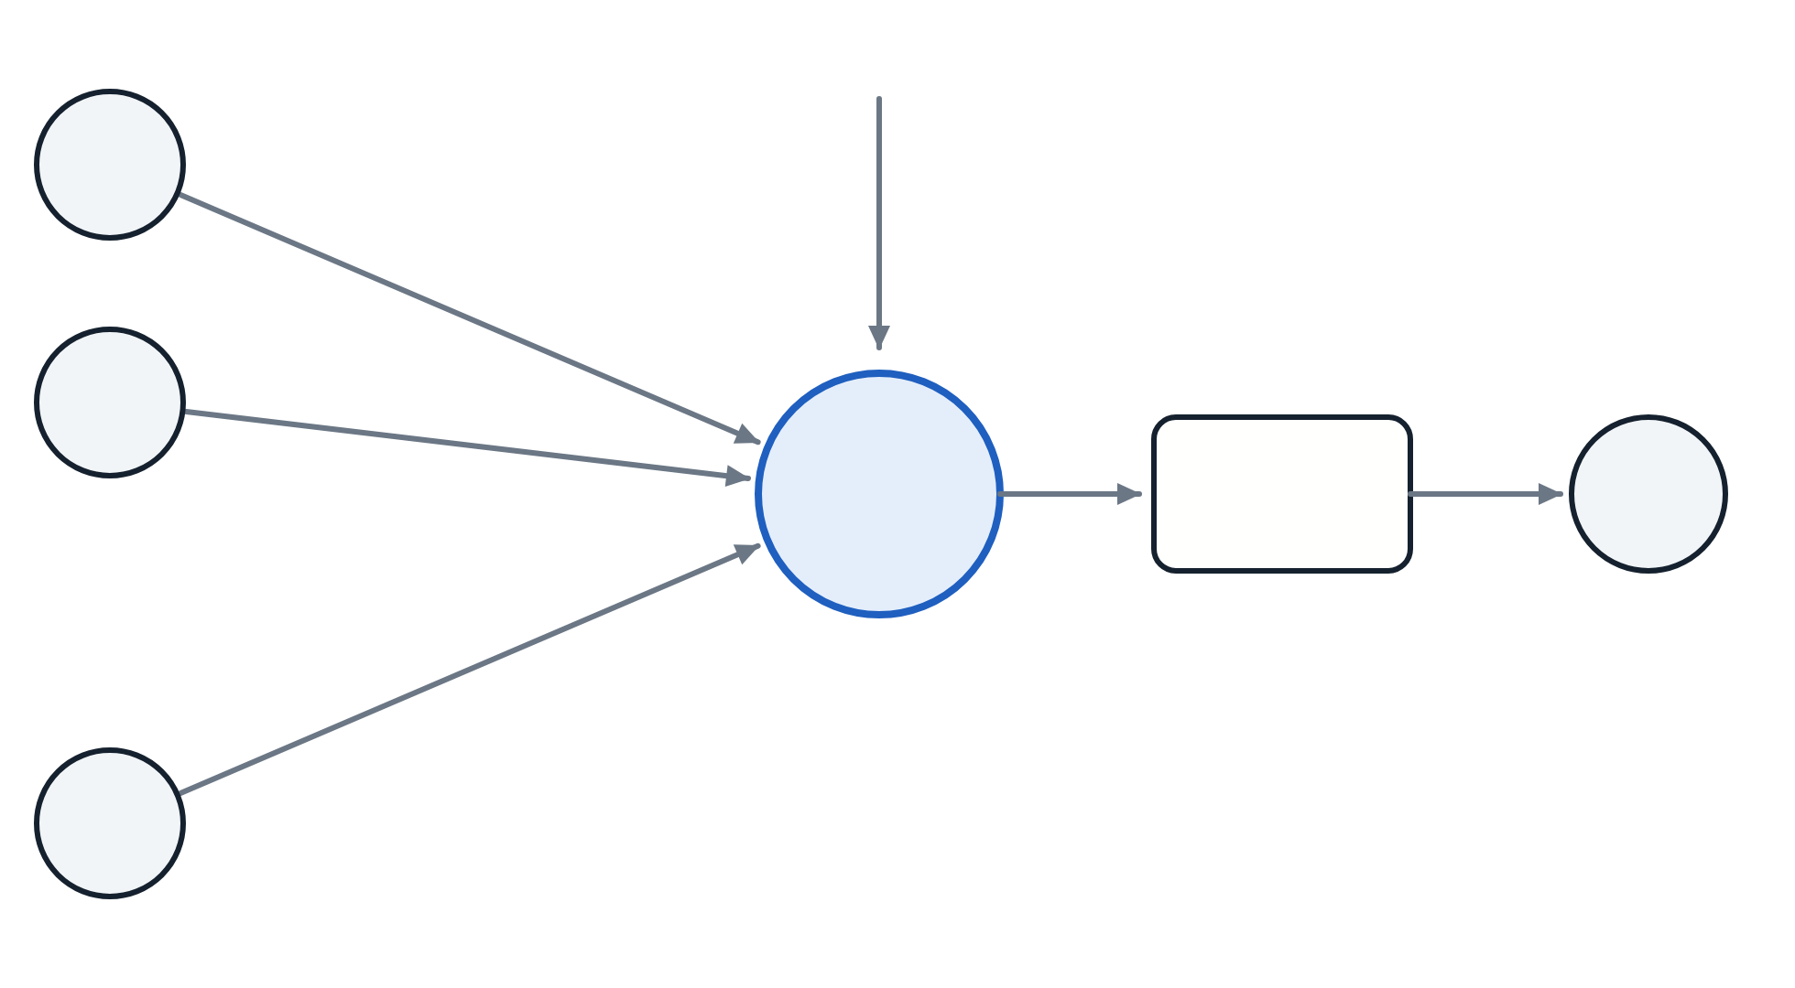
An artificial neuron computes a weighted sum plus a bias, then applies a nonlinearity.
§2 · THE ARTIFICIAL NEURON
z = Σᵢ wᵢxᵢ + b
= wᵀx + b
a = g(z)
b
x₁
w₁
x₂
w₂
Σ
Mental model: a learned linear feature detector followed by a soft threshold.
g(·)
a
⋮
a = g(z)
z = wᵀx + b
activation
wₙ
pre-activation
xₙ
Lecture 1 · Foundations: from linear models to the MLP
10 / 30
Notes:
An artificial neuron does exactly two things. It computes z, a weighted sum of its inputs plus a bias, and then passes z through a nonlinear function g to produce the activation a. Everything in this course is built from this and nothing else. The biological story maps neatly onto the equations: inputs are incoming signals, weights are synaptic strengths, the sum is integration at the cell body, the bias sets the threshold, and g is the firing decision. Then discard most of it. Real neurons communicate with timed spikes, real dendrites do nonlinear computation of their own, and real brains have no backpropagation. A better mental model is a learned linear feature detector followed by a soft threshold. One more way to hold it: a neuron asks one yes-or-no question about its input, and the weights define the question. A layer asks many questions in parallel, and the next layer asks questions about the answers.

Slide 11
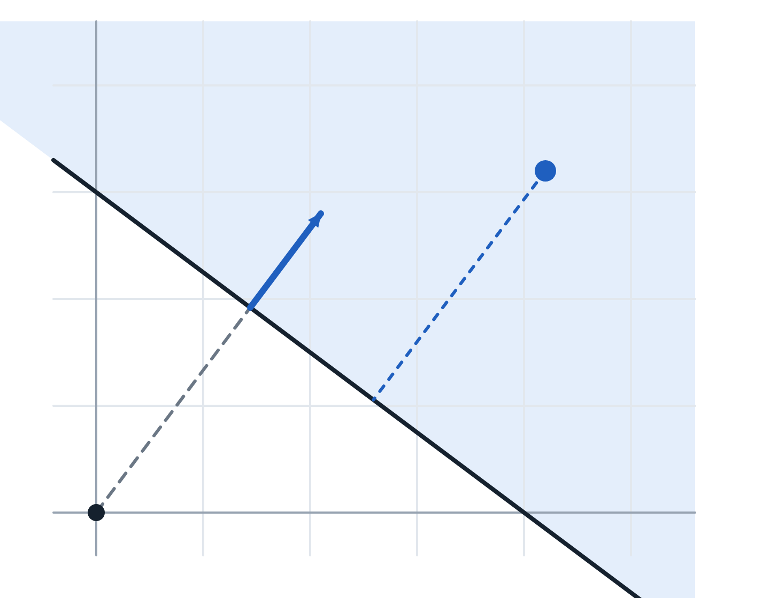
The weight vector sets the boundary’s orientation, and the bias shifts it without rotating it.
§2 · THE ARTIFICIAL NEURON
z < 0
z > 0
x
w
w is perpendicular. For x, x′ on the boundary, wᵀ(x − x′) = 0.
Bias shifts, never rotates. The origin is |b|/‖w‖ from the boundary. Without a bias, every boundary passes through the origin.
z/‖w‖
z is a signed distance. (wᵀx + b)/‖w‖, so |z| behaves like confidence.
|b|/‖w‖
origin
wᵀx + b = 0
Lecture 1 · Foundations: from linear models to the MLP
11 / 30
Notes:
This geometry pays for itself many times over. The set of points where w transpose x plus b equals zero is a hyperplane: a line in 2-D, a plane in 3-D. Fact one: w is perpendicular to it. Take two points on the boundary, subtract their equations, and w transpose the difference is zero. So w points in the direction of steepest increase of the score. Fact two: the bias shifts the hyperplane but does not rotate it; the distance from the origin is the absolute value of b over the norm of w. Remove biases and every boundary is forced through the origin, which is often crippling. Fact three: for any point, z divided by the norm of w is its signed distance from the boundary, so the pre-activation is a confidence-like measure. The next slide shows the consequence: the direction of w sets the orientation, while its magnitude sets how sharply the activation transitions.

Slide 12
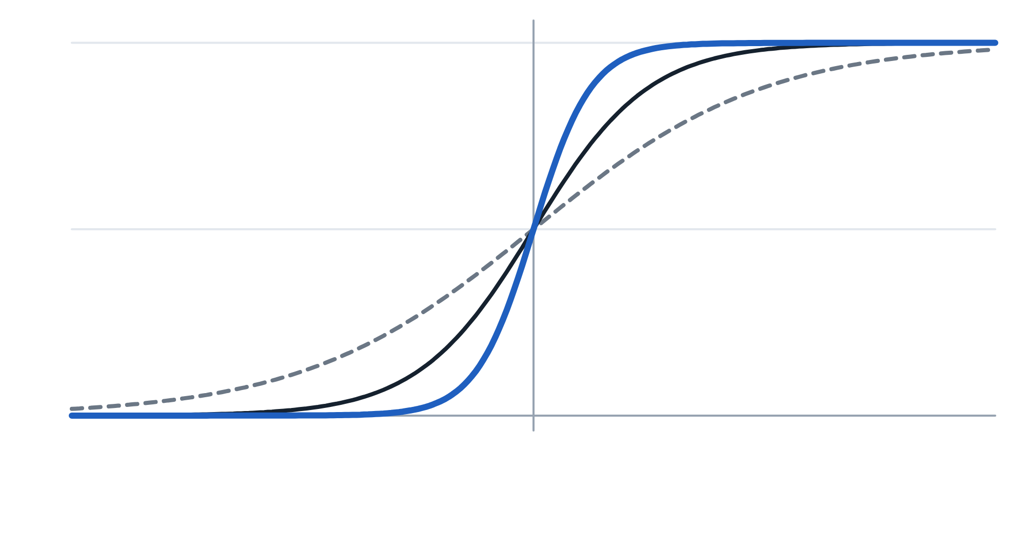
The size of w sets how sharply a neuron switches, not where its boundary lies.
§2 · THE ARTIFICIAL NEURON
k = 4
k = 2
Same boundary. Scaling w and b by k leaves wᵀx + b = 0 unchanged.
k = 1
Steeper switch. The sigmoid becomes k times steeper across it.
Why it matters. Weight decay shrinks ‖w‖ to make the function smoother without moving boundaries (§12).
−3
boundary
3
signed distance from the boundary; curves show σ(k · z) for w, b scaled by k
Lecture 1 · Foundations: from linear models to the MLP
12 / 30
Notes:
One consequence of the geometry is worth its own slide. The direction of w determines the orientation of the boundary, and the magnitude of w determines how sharply the activation transitions across it. Multiply both w and b by a constant k and the boundary, where w transpose x plus b equals zero, stays exactly where it was. But the sigmoid becomes k times steeper across it, as the three curves show. Weight decay in Section 12 exploits exactly this: shrinking the norm of w makes the model less confident and smoother, without moving its boundaries. Keep it in mind for initialization too: very large weights push sigmoid units into saturation.

Slide 13

The perceptron converges on separable data, but its step function provides no gradient.
§2 · THE ARTIFICIAL NEURON
Converges on separable data. With ‖x‖ ≤ R and margin γ, at most (R/γ)² mistakes (Novikoff, 1962).
g(z) = 1 if z ≥ 0, else 0
Never stops otherwise. On non-separable data it oscillates forever.
g′(z) = 0 wherever defined
No gradient. The step’s zero derivative means stacked perceptrons cannot be trained. Hence smooth activations.
z = 0
UPDATE ON EACH MISTAKE
w ← w + η (y − ŷ) x
b ← b + η (y − ŷ)
Lecture 1 · Foundations: from linear models to the MLP
13 / 30
Notes:
Rosenblatt's perceptron of 1958 used a hard step activation and a beautifully simple learning rule. For each misclassified example, add eta times y minus y-hat times x to the weights. If the truth was one and you predicted zero, you add a bit of x, which increases w transpose x and pushes the prediction toward one. The convergence theorem, Novikoff 1962, says that if the data are linearly separable, this finds a separating hyperplane in a finite number of updates. Quantitatively: if every input has norm at most R and some separator achieves margin gamma, the perceptron makes at most R over gamma, squared, mistakes. If they are not separable, it never terminates and oscillates forever. Two things killed it as a general tool. It only handles linearly separable data, as XOR showed. And more fundamentally, the step function has zero derivative everywhere it is defined and is undefined at zero, so there is no gradient signal to send backwards through a stack. That single fact is the reason modern networks use smooth activations.

Slide 14
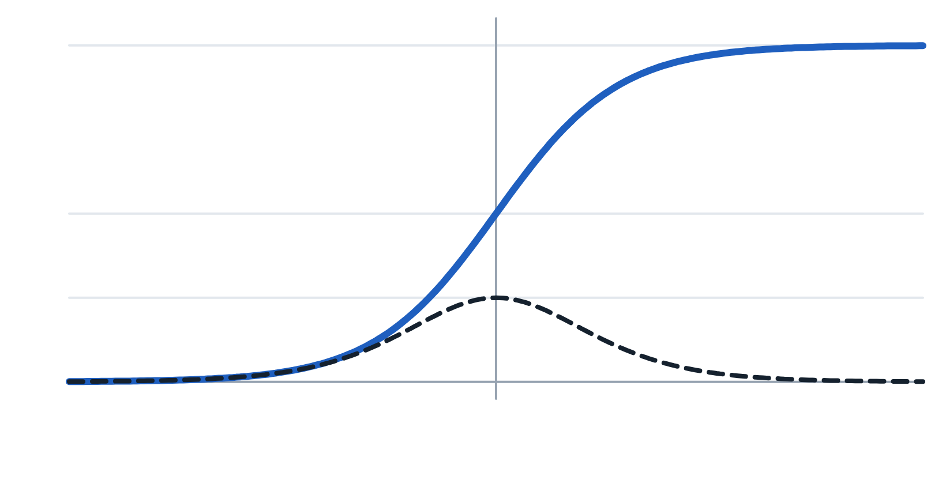
The sigmoid is the inverse of linear log-odds, not an arbitrary squashing function.
§2 · THE ARTIFICIAL NEURON
ASSUME LINEAR LOG-ODDS, SOLVE FOR P
1
log( p / (1 − p) ) = wᵀx + b = z
p / (1 − p) = exp(z)
p = exp(z) / (1 + exp(z))
= 1 / (1 + exp(−z)) = σ(z)
σ(z)
0.5
σ′(z), max 0.25
DERIVATIVE, MAX 0.25 AT Z = 0
−6
0
6
σ′(z) = σ(z) · (1 − σ(z))
Logistic regression is a single neuron: P(y = 1 | x) = σ(wᵀx + b).
Lecture 1 · Foundations: from linear models to the MLP
14 / 30
Notes:
Swap the step for the sigmoid and you have logistic regression. It maps any real number into the open interval zero to one, so the output reads as a probability that y equals one. Why this squashing function? Assume the log-odds of the two classes are linear in x, which is exactly the logistic regression assumption. Write p for the probability, exponentiate both sides, and solve: p equals e to the z over one plus e to the z, which is one over one plus e to the minus z. The sigmoid is the inverse of the log-odds function. Worth remembering for interviews. Its derivative has a famously convenient form, sigma times one minus sigma, with a maximum of 0.25 at z equals zero. Once you have the forward output you get the derivative for free. Hold on to that 0.25; it comes back to haunt us when we talk about vanishing gradients.

Slide 15
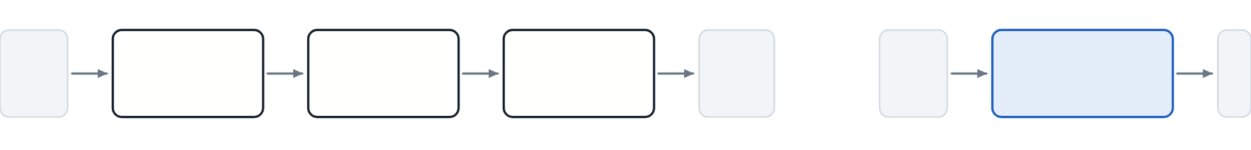
Without a nonlinearity, any stack of linear layers collapses into one linear layer.
§3 · ACTIVATION FUNCTIONS
x
W[1], b[1]
W[2], b[2]
W[3], b[3]
a[3]
≡
x
W′, b′
a
no activation between layers
one linear layer
SUBSTITUTE UPWARD
a[3] = W[3](W[2](W[1]x + b[1]) + b[2]) + b[3]
= (W[3]W[2]W[1]) x + (W[3]W[2]b[1] + W[3]b[2] + b[3])
= W′ x + b′
A narrow middle layer can even hurt: rank(W[3]W[2]W[1]) is at most the smallest factor’s rank.
Lecture 1 · Foundations: from linear models to the MLP
15 / 30
Notes:
Activation functions are not a detail. Take a three-layer network with no activation, just linear maps, and substitute upward. a2 is W2 W1 x plus a bias term. a3 is W3 W2 W1 x plus another bias term. Define W-effective as the product of the three matrices and b-effective as the collected bias. Then a3 equals W-effective x plus b-effective: a single linear layer. Depth without nonlinearity buys nothing. There is even a loss: the rank of a product is at most the minimum rank of its factors, so a narrow middle layer can only make the effective map worse than one unconstrained layer. This is the single most-asked conceptual interview question in the field, and the answer is this composition argument. You should be able to write it in thirty seconds.

Slide 16
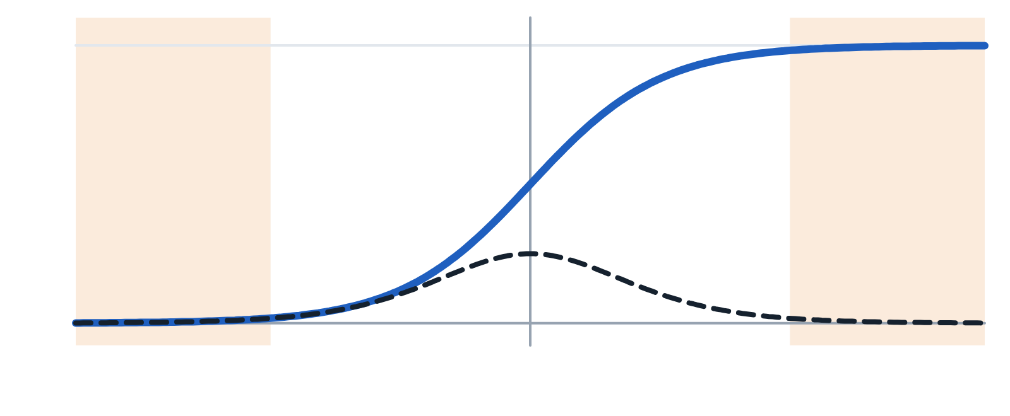
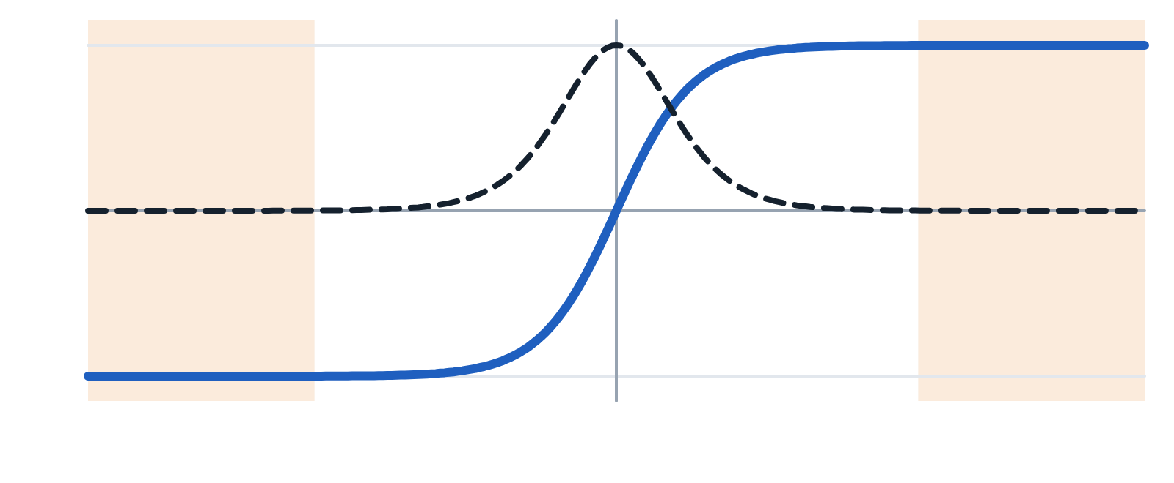
Sigmoid and tanh saturate at both tails, so their gradients vanish in deep stacks.
§3 · ACTIVATION FUNCTIONS
saturated
σ(z)
saturated
tanh′ ≤ 1
tanh(z)
σ′ ≤ 0.25
saturated
saturated
−6
0
6
−6
0
6
Ten sigmoid layers scale gradients by at most 0.25¹⁰ ≈ 10⁻⁶. Outputs are all positive, so updates zigzag.
tanh(z) = 2σ(2z) − 1 is zero-centred with slope up to 1, but both tails still saturate.
Lecture 1 · Foundations: from linear models to the MLP
16 / 30
Notes:
Now the menu, starting with the classics. Sigmoid is smooth, bounded, and interpretable as a probability, but it has three serious problems. First, saturation: for absolute z above five, the derivative is below 0.007. Backpropagation multiplies these derivatives layer by layer, so with ten sigmoid layers the gradient is scaled by at most 0.25 to the tenth, about ten to the minus six, even in the best case. Second, its outputs are all positive, so gradients for the next layer's weights share a sign for a given example and updates zigzag. Third, the exponential is relatively expensive. Use sigmoid today only for binary output layers and gates in LSTMs and GRUs. Tanh is a rescaled sigmoid, two sigma of two z minus one. It is zero-centred and its maximum derivative is one rather than a quarter, which softens the problem. But the shaded tails still saturate, so it is rarely chosen for new deep feedforward or convolutional models.

Slide 17
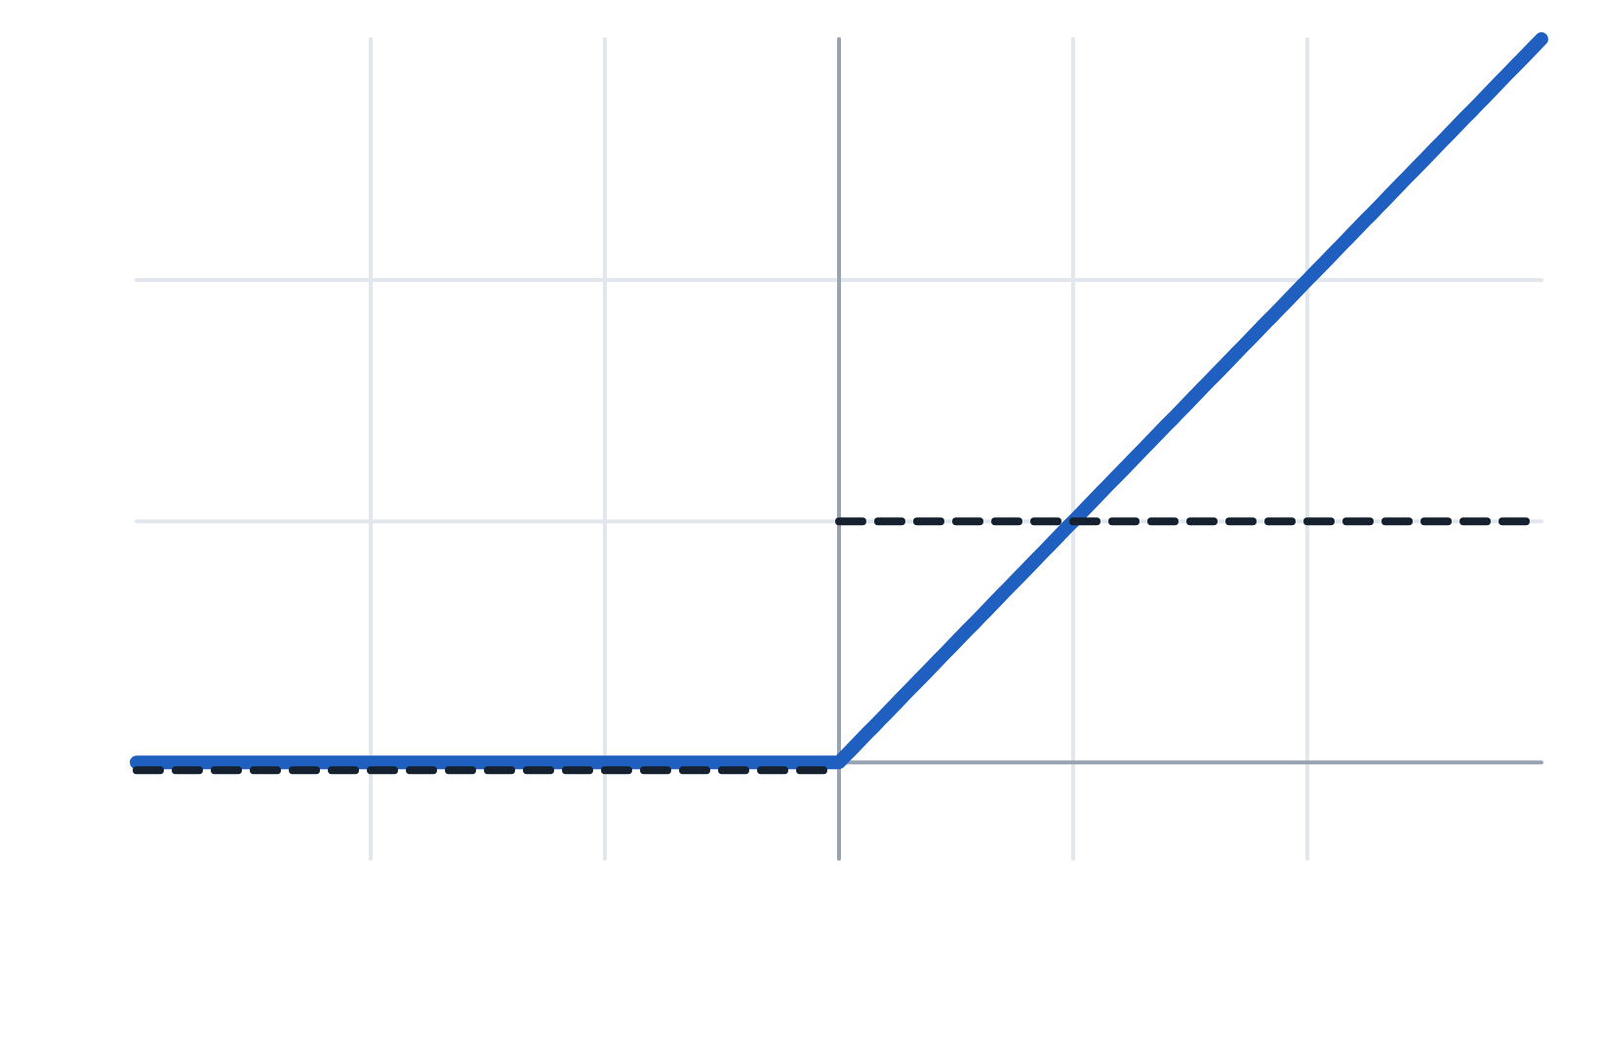
ReLU passes gradients through undiminished when active, which made deep networks trainable.
§3 · ACTIVATION FUNCTIONS
No positive saturation. Gradients pass through undiminished whenever the unit is active.
ReLU(z) = max(0, z)
Cheap and sparse. One comparison, and often half the units output exactly 0.
Still nonlinear. ReLU networks fit a different linear function on each polyhedral region.
ReLU′ = 1
ReLU′ = 0
Dying ReLU. A unit with z < 0 for every input gets zero gradient forever.
−2
0
2
z
Lecture 1 · Foundations: from linear models to the MLP
17 / 30
Notes:
ReLU, max of zero and z, is the workhorse. It looks almost too simple to work. Its derivative is exactly one whenever the unit is active, so gradients pass through undiminished: the single biggest reason deep networks became trainable around 2012. It is cheap, one comparison. It gives sparse activations. And despite being piecewise linear it is still nonlinear: a ReLU network carves input space into polyhedral regions and fits a different linear function on each. The cost is the dying ReLU problem. If a big update pushes a unit's weights so that z is negative for every input, it outputs zero forever, its gradient is zero forever, and it never recovers. After a bad learning-rate choice that can be twenty to forty percent of a layer. Fixes: lower the learning rate, use better initialization, or use a leaky variant.

Slide 18
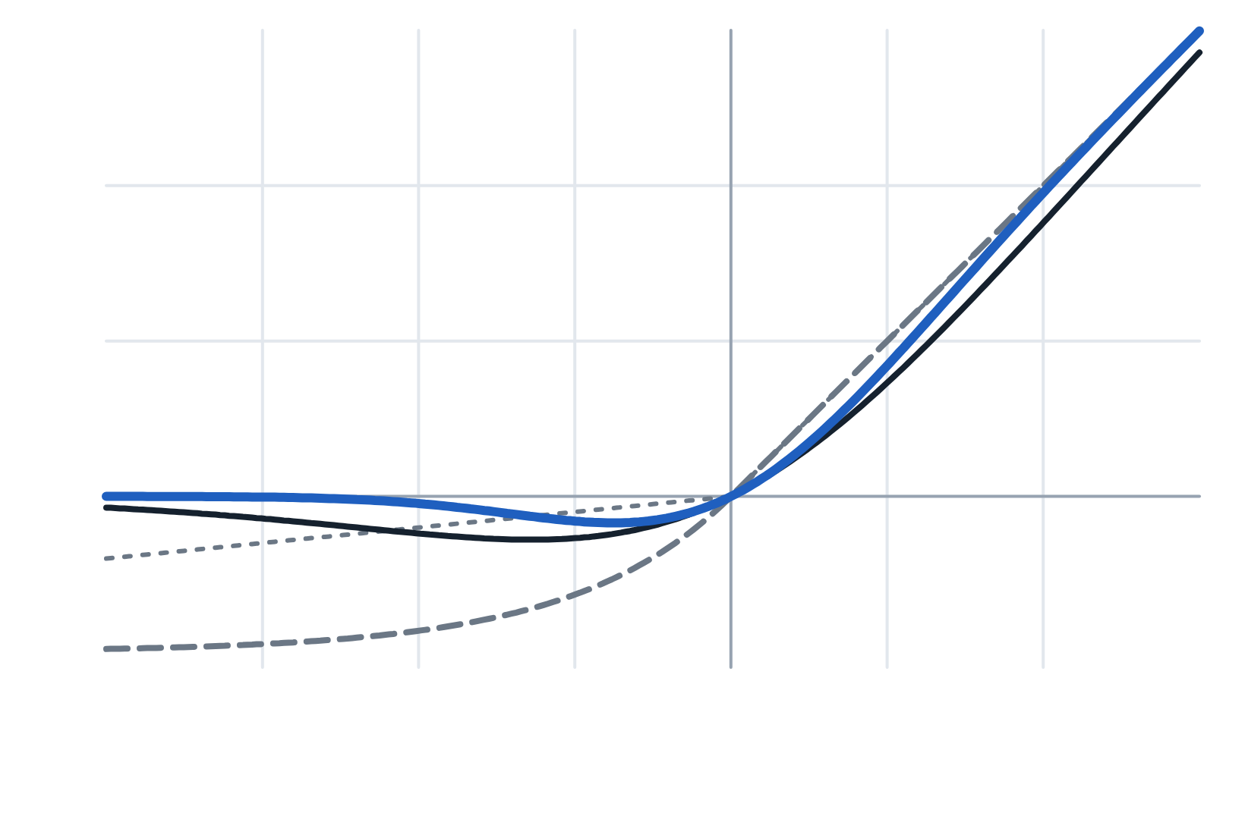
Leaky and smooth variants of ReLU keep a nonzero gradient for negative inputs.
§3 · ACTIVATION FUNCTIONS
LeakyReLU(z) = z if z > 0, else αz
ELU(z) = z if z > 0, else α(exp(z) − 1)
GELU(z) = z · Φ(z) Φ = normal CDF
SiLU(z) = z · σ(z) also Swish
GELU
GELU is standard in Transformers, SiLU in EfficientNet, Leaky ReLU in GAN discriminators.
Leaky (α = 0.1)
ELU
SiLU
−3
0
2
Leaky slope drawn at 0.1 for visibility; typical α = 0.01
Lecture 1 · Foundations: from linear models to the MLP
18 / 30
Notes:
The smooth and leaky relatives of ReLU all follow the identity for large positive inputs and differ on the negative side. Leaky ReLU keeps a small fixed slope alpha, typically 0.01; PReLU learns alpha per channel. Because the gradient is never exactly zero, units can come back from the dead, and Leaky ReLU is the standard choice in GAN discriminators. ELU uses alpha times exp of z minus one for negative inputs. GELU multiplies z by the standard normal CDF, read it as multiplying the input by the probability that a standard normal is below it, and it is the standard activation in Transformers such as BERT, GPT and Vision Transformers. SiLU, also called Swish, is z times sigma of z and appears in EfficientNet and many detectors. For a first CNN, ReLU and GELU perform within noise of each other. Do not agonize.

Slide 19
ReLU remains the default hidden activation, and GELU is standard in Transformers.
§3 · ACTIVATION FUNCTIONS
Function | Range | Max g′ | Saturates | Typical use
Sigmoid | (0, 1) | 0.25 | Both tails | Binary output; LSTM gates
Tanh | (−1, 1) | 1.0 | Both tails | RNN hidden states
ReLU | [0, ∞) | 1.0 | Negative side | Default for CNNs and MLPs
Leaky ReLU | (−∞, ∞) | 1.0 | No | GANs; when ReLUs die
ELU | (−α, ∞) | 1.0 | Negative tail | Occasional alternative
GELU | ≈ (−0.17, ∞) | ≈ 1.1 | No | Transformers, ViTs
SiLU | ≈ (−0.28, ∞) | ≈ 1.1 | No | EfficientNet, detectors
Softmax | (0, 1), sums to 1 | — | — | Multi-class output layer
Lecture 1 · Foundations: from linear models to the MLP
19 / 30
Notes:
Here is the whole menu in one table, the kind of thing worth having on a single page when you review. Read it by columns. Range tells you what the unit can output. The maximum derivative tells you how well gradients can pass: a quarter for sigmoid, about one for everything modern. Saturation tells you where gradients die. The highlighted ReLU row is the default for CNNs and MLPs. GELU and SiLU dip slightly negative and peak slightly above one in slope, which is why the table says roughly 1.1. Softmax is the odd one out: it is not elementwise, every output depends on all inputs, and it belongs at the output layer with the losses in Section 5.

Slide 20
Choose the activation by layer role, and leave classification outputs as raw logits.
§3 · ACTIVATION FUNCTIONS
Layer role | Activation | Why
Hidden layers | ReLU | Switch to Leaky ReLU or GELU if many units are dead
Transformer blocks | GELU | The architecture was tuned with it
Binary output | None (raw logit) | Use a loss that applies the sigmoid internally (§5)
Multi-class output | None (raw logits) | The cross-entropy loss applies softmax internally
Regression output | None | A bounded output caps what the model can predict
Positive output | Softplus or ReLU | Or predict log y and exponentiate
Lecture 1 · Foundations: from linear models to the MLP
20 / 30
Notes:
A decision rule you can actually follow. Hidden layers: start with ReLU, and if you suspect dying units, check what fraction of activations are exactly zero, then switch to Leaky ReLU or GELU. Transformer blocks: GELU, because that is what the architecture was tuned with. At the output, the activation follows the task. Binary classification is a sigmoid in principle, but in practice you leave the output as a raw logit and let BCEWithLogitsLoss handle it; Section 5 explains why. Multi-class is softmax in principle, raw logits with CrossEntropyLoss in practice. Regression gets no activation at all, because a bounded activation caps what the model can predict. If the output must be positive, use ReLU or softplus, or predict the log and exponentiate. On the framework side: PyTorch offers every activation both as a layer object and as a plain function. They compute the same thing.

Slide 21
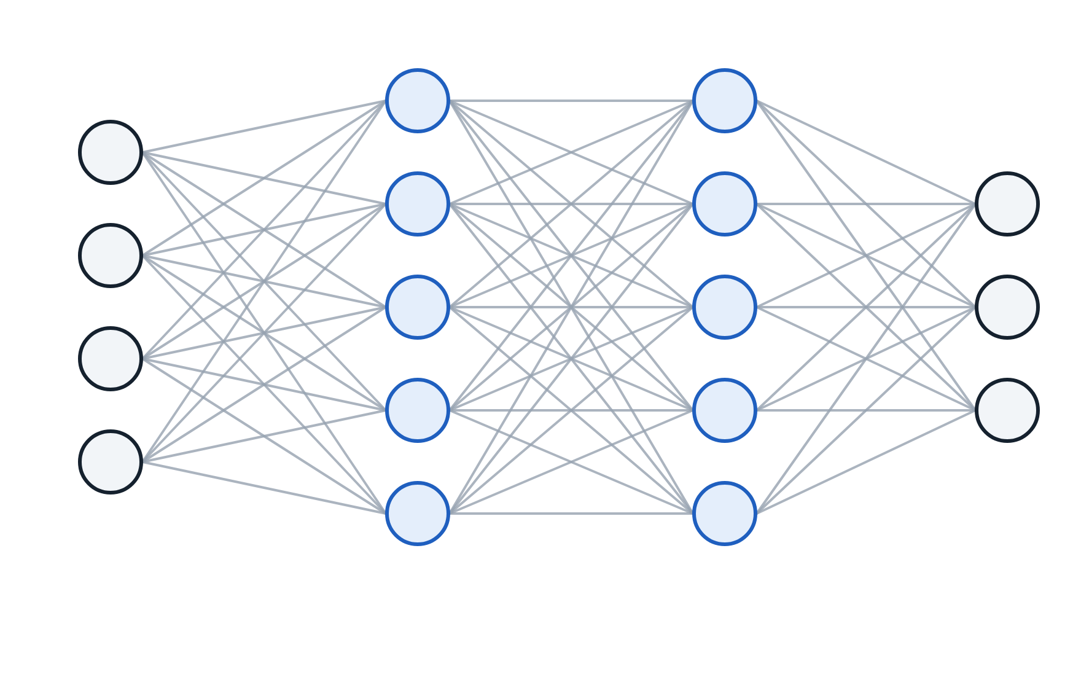
An MLP’s forward pass applies the same two-step rule at every layer.
§4 · THE MLP FORWARD PASS
W[1]
W[2]
W[L]
FORWARD PASS, ONE EXAMPLE
a[0] = x
for l = 1, …, L:
z[l] = W[l] a[l−1] + b[l]
a[l] = g[l](z[l])
ŷ = a[L]
Everything else is choosing g, measuring the error in ŷ, or differentiating that error.
a[0] = x
a[1]
a[2]
ŷ = a[L]
n[0]
n[1]
n[2]
n[L]
Lecture 1 · Foundations: from linear models to the MLP
21 / 30
Notes:
An MLP is a stack of fully connected layers, each followed by a nonlinearity. Fully connected means every unit receives input from every unit in the previous layer. Layer zero is the input and is not counted as a layer, since it has no parameters. Layer L is the output. The forward pass for one example is just this loop: start with a0 equal to x, and for each layer compute the pre-activation z equals W times the previous activation plus b, then apply g. The prediction is the last activation. That is the entire forward pass. Everything else in the course is about choosing g, choosing how to measure the error in y-hat, or computing derivatives of that error. Next, the shapes.

Slide 22
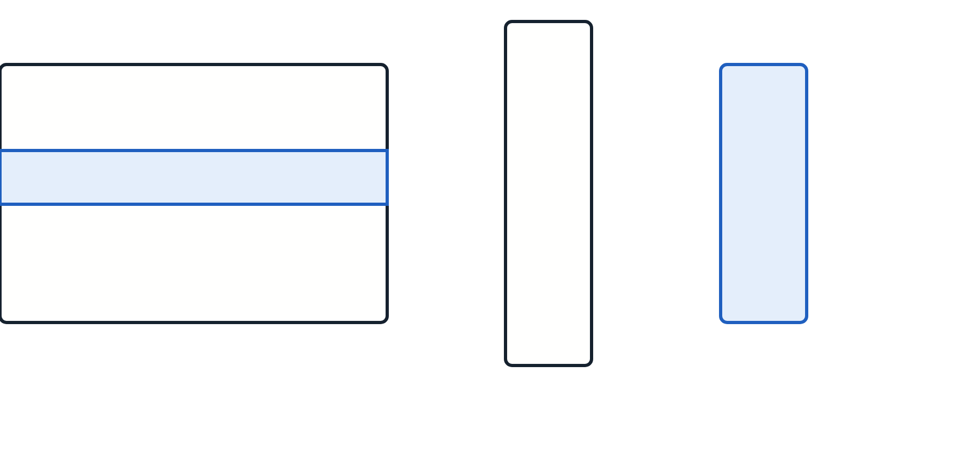
W[l] has shape (n[l], n[l−1]) because each row holds one unit’s weights.
§4 · THE MLP FORWARD PASS
W[l]
row i: unit i’s weights
×
a
=
z
Rows. Row i of W[l] holds unit i’s weights: one per unit in layer l−1.
Count. There are n[l] rows, so (n[l], n[l−1]) × (n[l−1], 1) = (n[l], 1).
(n[l], n[l−1])
(n[l], 1)
(n[l−1], 1)
Recovery. When shapes confuse you, write what one row means, then count.
Lecture 1 · Foundations: from linear models to the MLP
22 / 30
Notes:
Why does W of layer l have shape n of l by n of l minus one? Row i of the matrix holds the weights of unit i in layer l. That row needs one entry per unit in the previous layer, so its length is n of l minus one, and there are n of l such rows. The matrix-vector product then has shape n of l by n of l minus one, times n of l minus one by one, giving n of l by one. Correct. When shapes confuse you, this is the recovery procedure: write out what one row means, then count. It resolves almost every shape bug you will meet.

Slide 23


Frameworks store examples as rows, so a linear layer computes X Wᵀ + b.
§4 · THE MLP FORWARD PASS
MATH: EXAMPLES AS COLUMNS
FRAMEWORKS: EXAMPLES AS ROWS
W[l]
×
A[l−1]
=
Z[l]
A[l−1]
×
W[l]ᵀ
=
Z[l]
(n[l], n[l−1])
(n[l−1], m)
(n[l], m)
(m, n[l−1])
(n[l−1], n[l])
(m, n[l])
Z[l] = W[l] A[l−1] + b[l]
Z[l] = A[l−1] W[l]ᵀ + b[l]
PyTorch’s linear layer stores W as (out, in), the math layout, but multiplies row-batches by Wᵀ.
Lecture 1 · Foundations: from linear models to the MLP
23 / 30
Notes:
In practice you never process one example at a time; you stack m examples into a matrix. Two conventions exist, and mixing them causes endless bugs. In the math-textbook convention, on the left, each column is an example: Z equals W times A plus b, with the bias broadcast across columns. In the framework convention that PyTorch uses, on the right, each row is an example: Z equals A times W transpose plus b, with b broadcast across rows. Here is the detail that resolves most why-is-my-matmul-failing moments: nn.Linear stores its weight in the math convention, out-features by in-features, but the data flows as rows, so internally it multiplies by the transpose. I use the math convention for derivations because it is cleaner, and the row convention for anything you will type.

Slide 24
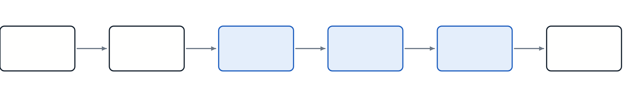
Through a 784→128→64→10 classifier, the batch dimension never changes.
§4 · THE MLP FORWARD PASS
Images
Flatten
Hidden 1
Hidden 2
Logits
Softmax
(32,1,28,28)
(32, 784)
(32, 128)
(32, 64)
(32, 10)
(32, 10)
W[1]: (128, 784)
W[2]: (64, 128)
W[3]: (10, 64)
rows sum to 1
The batch dimension never changes: 32 in, 32 out. If it does, a reshape is wrong.
The output layer has no activation. The loss applies softmax internally (§5).
Lecture 1 · Foundations: from linear models to the MLP
24 / 30
Notes:
Let us trace a real example: a classifier on 28 by 28 grayscale images, ten classes, hidden layers of 128 and 64 units, batch size 32. The input arrives as 32 by 1 by 28 by 28: batch, channels, height, width. Flattening gives 32 by 784. The first linear layer has weight 128 by 784, so Z1 and A1 are 32 by 128. Then 32 by 64. Then the logits, 32 by 10, with no activation, because the loss will handle softmax. If you apply softmax for inspection, each row sums to one. Notice the one invariant: the batch dimension never changes. Thirty-two goes in, thirty-two comes out. If your batch dimension changes size mid-network, you have made an error, almost always a wrong reshape or view.

Slide 25

Layer 1 holds 92% of the 109,386 parameters because the input is large.
§4 · THE MLP FORWARD PASS
Layer 1
784·128 + 128
WEIGHTS PLUS BIASES
100,480
params = Σₗ (n[l]·n[l−1] + n[l])
L1: 100,352 + 128 = 100,480
L2: 8,192 + 64 = 8,256
L3: 640 + 10 = 650
total = 109,386
Layer 2
128·64 + 64
8,256
Layer 3
64·10 + 10
Fully connecting a large input is expensive — the seed of the case for convolutions.
650
Layer 1 alone: 92% of 109,386
Lecture 1 · Foundations: from linear models to the MLP
25 / 30
Notes:
Counting parameters is a habit worth building. Layer l has n of l times n of l minus one weights plus n of l biases. For our network: layer one is 784 times 128 plus 128, which is 100,480. Layer two is 8,256. Layer three is 650. The total is 109,386. Look at the bars. Layer one holds 92 percent of the parameters, purely because the input is large and fully connected to 128 units. That observation is the seed of the entire convolutional network argument later in the tutorial. In PyTorch you can check the count with a one-line sum of numel over the parameters that require gradients. Do it every time you build a model.

Slide 26
Universal approximation guarantees expressive power, not size, trainability or generalization.
§4 · THE MLP FORWARD PASS
THEOREM · CYBENKO 1989; HORNIK 1991 (INFORMAL)
For continuous f on a compact K ⊂ ℝⁿ and any ε > 0, a single-hidden-layer network with finitely many units and a non-polynomial activation achieves |F(x) − f(x)| < ε on all of K.
Continuous, compact
No size bound
Exists ≠ findable
Fit ≠ generalize
Width can be exponential in the input dimension.
Gradient descent may not find the weights.
Silent about test error.
Not “any function”.
Lecture 1 · Foundations: from linear models to the MLP
26 / 30
Notes:
You will hear that a neural network can approximate any function. That is a garbled version of a real theorem. Here is the real one, from Cybenko and Hornik: a continuous function on a compact set can be approximated to any accuracy by a single hidden layer with finitely many units and a non-polynomial activation. Four qualifications, each of which people drop. Continuous, on a closed and bounded set, not any function. Finite, but the theorem says nothing about how many; the width can be exponential in the input dimension. Existence, not findability: no promise gradient descent finds the weights. And approximation, not generalization: fitting the training data arbitrarily well is exactly what overfitting looks like. So what is it good for? It settles one question: expressive power is not the bottleneck. When your model performs badly, look at optimization, regularization, data, or architecture. There is also a dual result, Lu and colleagues 2017: networks of bounded width but unbounded depth are universal too. Lecture 3 returns to depth.

Slide 27
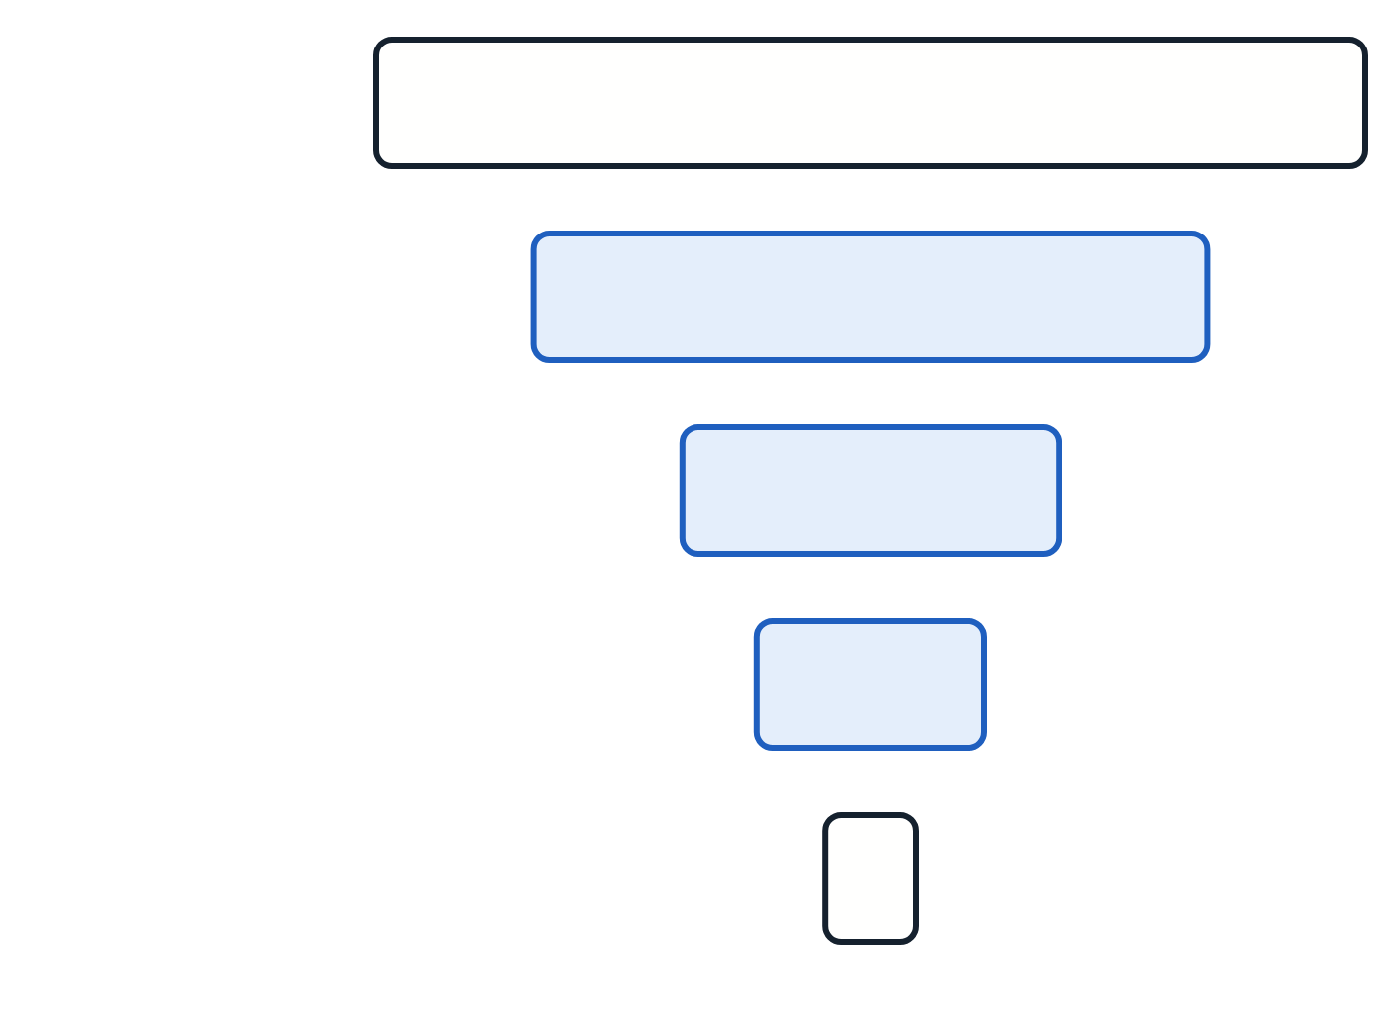
Start with two hidden layers in a funnel, and confirm the model can overfit a small subset.
§4 · THE MLP FORWARD PASS
input
784
hidden
512
Fixed ends. Input size comes from the data, output size from the task.
hidden
256
Start with two hidden layers. More rarely helps on tabular data without residual connections.
hidden
128
Golden rule. A model that cannot overfit 100 examples has a bug, not a capacity problem.
output
10
Lecture 1 · Foundations: from linear models to the MLP
27 / 30
Notes:
Practical starting points. The input size is fixed by your data and the output size by your task: one unit for regression or binary classification, K units for K classes. Start with two hidden layers; going from one to two usually helps, going to ten rarely helps on tabular data and often hurts without residual connections. Pick widths in powers of two, which map well to GPU memory, often as a funnel. The golden rule: build the smallest network that can overfit a small subset of your training data, confirm it does, then add regularization and scale up.

Slide 28
Three silent framework mistakes leave a model unable to learn.
§4 · THE MLP FORWARD PASS
Calling the forward method directly
Skipping the parent constructor
Keeping layers in a plain list
A custom module must call its parent-class constructor first. Otherwise no parameters register and the optimizer updates nothing.
Call the model object itself. Calling its forward method skips registered hooks, which breaks debugging and quantization tools.
An ordinary Python list hides layers from the framework. Use its module-list container instead.
The symptom is the same in each case: training runs, the loss is reported, and nothing improves.
Lecture 1 · Foundations: from linear models to the MLP
28 / 30
Notes:
Three PyTorch mistakes that fail silently, all about how the framework registers your model. First, call the model object itself rather than its forward method. Calling forward directly skips registered hooks, which silently breaks many debugging and quantization tools. Second, a custom module must call its parent-class constructor before anything else. Omit it and PyTorch cannot register your parameters, so the parameter list is empty and the optimizer updates nothing. The model trains, reports a loss, and never improves. Third, layers stored in an ordinary Python list are not registered either. Use the framework's module-list or sequential container for collections of layers. If your loss sits perfectly still for many epochs, check these three first.

Slide 29
Each section of today’s lecture reduces to one sentence worth remembering.
RECAP
§1
A hard problem in one representation can be easy in another, and networks learn that representation.
§2
A neuron is a linear feature detector, wᵀx + b, followed by a soft threshold g.
§3
Without a nonlinearity depth collapses to one linear layer. ReLU is the default.
§4
The forward pass repeats z = Wa + b, a = g(z). Check shapes by counting rows.
Lecture 1 · Foundations: from linear models to the MLP
29 / 30
Notes:
To recap Lecture 1 in four sentences. Section 1: a hard problem in one representation can be easy in another, and neural networks learn that representation instead of having an expert design it. Section 2: a neuron is a learned linear feature detector followed by a soft threshold, with w setting orientation and sharpness and b setting offset. Section 3: without a nonlinearity, any depth collapses to one linear layer; ReLU is the default hidden activation. Section 4: the forward pass repeats one two-step rule per layer, and shapes are checked by asking what one row means. Next lecture: how we measure error, how backpropagation computes every gradient at once, and how gradient descent uses them.

Slide 30
These are the primary sources behind today’s claims, for further reading.
REFERENCES
McCulloch, W. & Pitts, W. (1943). A logical calculus of the ideas immanent in nervous activity.
Cybenko, G. (1989). Approximation by superpositions of a sigmoidal function.
Rosenblatt, F. (1958). The perceptron: a probabilistic model for information storage and organization in the brain.
Hornik, K. (1991). Approximation capabilities of multilayer feedforward networks.
Novikoff, A. (1962). On convergence proofs for perceptrons.
Lu, Z. et al. (2017). The expressive power of neural networks: a view from the width.
Minsky, M. & Papert, S. (1969). Perceptrons. MIT Press.
Rumelhart, D., Hinton, G. & Williams, R. (1986). Learning representations by back-propagating errors. Nature.
Krizhevsky, A., Sutskever, I. & Hinton, G. (2012). ImageNet classification with deep CNNs (AlexNet).
LeCun, Y. et al. (1998). Gradient-based learning applied to document recognition.
Hendrycks, D. & Gimpel, K. (2016). Gaussian error linear units (GELUs).
Clevert, D.-A. et al. (2016). Fast and accurate deep network learning by ELUs.
Lecture 1 · Foundations: from linear models to the MLP
30 / 30
Notes:
These are the primary sources for today's claims. You do not need to read them for this course, but if you want to see where an idea came from, start with the perceptron convergence proof, the two universal approximation papers, and the GELU paper.

